Slide 1
Vali IT
SQL

Slide 2
JdbcTemplate
// INSERT, UPDATE, DELETE lause (ei tagasta midagi) jdbcTemplate.update(sql, paramMap); // SELECT tagastab 1 tulba ja 1 rea jdbcTemplate.queryForObject(sql, paramMap, String.class); // Select tagastab 1 tulba aga mitu rida jdbcTemplate.queryForList(sql, paramMap, String.class); // Select tagastab mitu tulpa aga 1 rea jdbcTemplate.queryForObject(sql, paramMap, new AccountRowMapper()); // Select tagastab mitu tulpa ja mitu rida jdbcTemplate.query(sql, paramMap, new AccountRowMapper());

Slide 3
JOIN (INNER JOIN)
SELECT * FROM employee e JOIN vacation v ON e.id = v.employee_id
Employee
Vacation
Id | Name
1 | John
2 | Teri
3 | Ronald
4 | Random
Id | Employee_id | date
1 | 1 | 2020-02-15
2 | 2 | 2020-05-12
3 | 3 | 2020-06-25
4 | 5 | 2020-10-03
e.Id | e.Name | v.Id | v.employee_id | v.date
1 | John | 1 | 1 | 2020-02-15
2 | Teri | 2 | 2 | 2020-05-12
3 | Ronald | 3 | 3 | 2020-06-25

Slide 4
JOIN (LEFT JOIN)
SELECT * FROM employee e LEFT JOIN vacation v ON e.id = v.employee_id
Employee
Vacation
Id | Name
1 | John
2 | Teri
3 | Ronald
4 | Random
Id | Employee_id | date
1 | 1 | 2020-02-15
2 | 2 | 2020-05-12
3 | 3 | 2020-06-25
4 | 5 | 2020-10-03
e.Id | e.Name | v.Id | v.employee_id | v.date
1 | John | 1 | 1 | 2020-02-15
2 | Teri | 2 | 2 | 2020-05-12
3 | Ronald | 3 | 3 | 2020-06-25
4 | Random | Null | Null | null

Slide 5
JOIN (RIGHT JOIN)
SELECT * FROM employee e RIGHT JOIN vacation v ON e.id = v.employee_id
Employee
Vacation
Id | Name
1 | John
2 | Teri
3 | Ronald
4 | Random
Id | Employee_id | date
1 | 1 | 2020-02-15
2 | 2 | 2020-05-12
3 | 3 | 2020-06-25
4 | 5 | 2020-10-03
e.Id | e.Name | v.Id | v.employee_id | v.date
1 | John | 1 | 1 | 2020-02-15
2 | Teri | 2 | 2 | 2020-05-12
3 | Ronald | 3 | 3 | 2020-06-25
Null | Null | 4 | 5 | 2020-10-03

Slide 6
JOIN (FULL OUTER)
SELECT * FROM employee e FULL OUTER JOIN vacation v ON e.id = v.employee_id
Employee
Vacation
Id | Name
1 | John
2 | Teri
3 | Ronald
4 | Random
Id | Employee_id | date
1 | 1 | 2020-02-15
2 | 2 | 2020-05-12
3 | 3 | 2020-06-25
4 | 5 | 2020-10-03
e.Id | e.Name | v.Id | v.employee_id | v.date
1 | John | 1 | 1 | 2020-02-15
2 | Teri | 2 | 2 | 2020-05-12
3 | Ronald | 3 | 3 | 2020-06-25
Null | Null | 4 | 5 | 2020-10-03
4 | Random | Null | Null | null

Slide 7
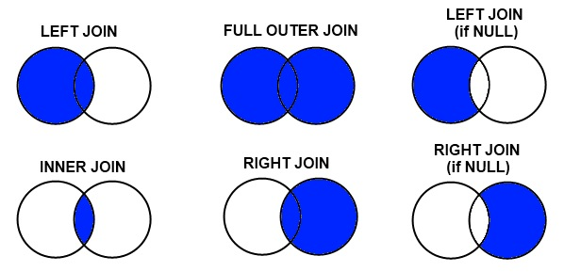
JOINS

Slide 8
JOIN (multiple rows)
SELECT * FROM employee e JOIN vacation v ON e.id = v.employee_id
Employee
Vacation
Id | Name
1 | John
2 | Teri
3 | Ronald
4 | Random
Id | Employee_id | date
1 | 1 | 2020-02-15
2 | 2 | 2020-05-12
3 | 3 | 2020-06-25
4 | 3 | 2020-10-03
e.Id | e.Name | v.Id | v.employee_id | v.date
1 | John | 1 | 1 | 2020-02-15
2 | Teri | 2 | 2 | 2020-05-12
3 | Ronald | 3 | 3 | 2020-06-25
4 | Ronald | 4 | 3 | 2020-10-03

